Slide 1
OK Provider Orientation Presentation
2024

Slide 2



Three Uniques
High-Touch
We go above and beyond to provide personalized, engaging, and responsive services to our members.
High Value
We work hard to offer affordable health insurance coverage with the benefits people truly want and need.
Partnership
We strive to be more than just a health insurance company – we want to be long term partners with our members.
Our approachable, local customer care team is ready to help our members by being responsive and going above and beyond.

Slide 3
Plans for 2024
D-SNP, C-SNP and HMO Plans – available in all 26 counties
H3706-028 Generations Dual Support (HMO D-SNP)
H3706-029 Generations Dual Premier (HMO D-SNP)
H3706-024 Generations Chronic Care (HMO C-SNP)
H3706-025 Generations Chronic Care Savings
(HMO C-SNP)
H3706-001 Generations Classic Rewards (HMO)
H3706-023 Generations Classic Plus (HMO)
H3706-009 Generations Valor (HMO-POS)

Slide 4
GlobalHealth C-SNP
What is a Chronic Special Needs Plan (C-SNP)?
GlobalHealth is offering a C-SNP for patients with chronic and disabling disorders.
To qualify a member must have:
Medicare Part A and Part B
Live in our service area
One or more of the follow chronic conditions:
  Diabetes
  Chronic Heart Failure
  Cardiovascular Disorders such as Cardiac Arrhythmias, Coronary Artery Disease, Peripheral Vascular Disease, and Chronic Venous Thromboembolic Disorder
NOTE: The enrollee’s ability to enroll will be based on verification that they have a qualifying specific severe or disabling chronic condition.

Slide 5
GlobalHealth C-SNP
Provider Network Access
GlobalHealth is responsible for maintaining a specialized provider network that corresponds to the needs of our members.
GlobalHealth coordinates care and ensures that providers:
Are accessible to members 24/7.
Collaborate with the ICT and contribute to a beneficiary’s ICP.
Provide clinical consultation.
Assist with developing and updating care plans.
Provide pharmacotherapy consultation and medication reconciliation.

Slide 6
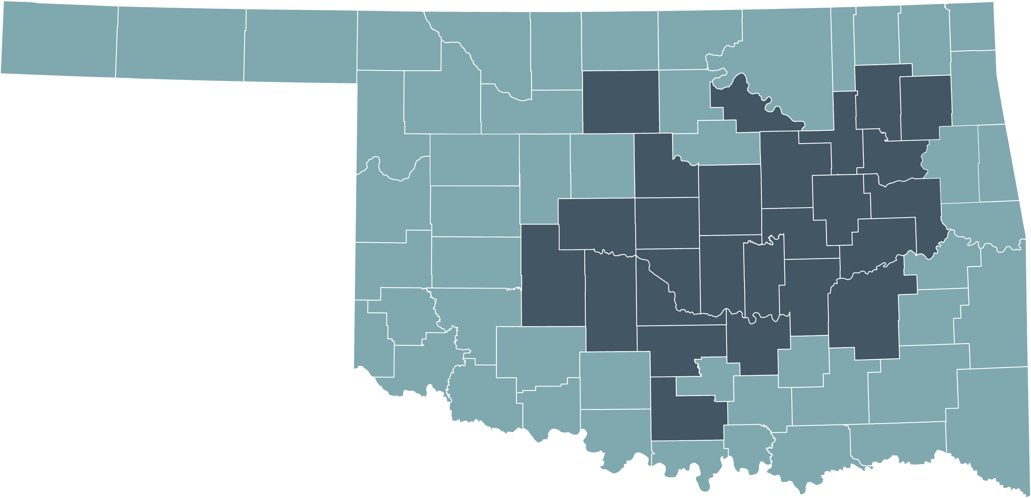
Eligibility & Service Area Map
26 COUNTY SERVICE AREA
Must be a permanent resident in our service area
Must have both Medicare Part A and Part B

Slide 7
2024 Plan Overview
Benefits are subject to change.
*Combined supplemental preventative and comprehensive
Plan | Product Type | Features
H3706-001 Generations Classic Rewards (HMO) | MAPD Giveback | $75 Monthly Part B Buydown; Smart Wallet: $500/yr D/V/H and $115/qtr OTC; $1,500 Dental *
H3706-023 Generations Classic Plus (HMO) | $0 Premium MAPD | Smart Wallet: $500/yr D/V/H and $115/qtr OTC; $2,000 Dental*
H3706-009 Generations Valor (HMO-POS) | $0 Premium MA Only | $75 Monthly Part B Buydown; Smart Wallet: $500/yr D/V/H and $100/qtr OTC; $1,500 Dental*
H3706-024 Generations Chronic Care (HMO C-SNP) | $0 Premium C-SNP | Smart Wallet: $1,000/yr D/V/H and $150/qtr OTC, Groceries and/or Gasoline; $2,000 Dental*
H3706-025 Generations Chronic Care Saving (HMO C-SNP) | Giveback C-SNP | $100 Monthly Part B Buydown; Smart Wallet: $1,000/yr D/V/H and $150/qtr OTC, Groceries and/or Gasoline; $2,000 Dental*
H3706-028 Generations Dual Support (HMO D-SNP) | D-SNP Partial | Smart Wallet: $500/yr D/V/H and $250/mo OTC, Groceries, Utilities and/or Gasoline; $0 copay Part D Drugs; $2,000 Dental*
H3706-029 Generations Dual Premier (HMO D-SNP) | D-SNP Full | Smart Wallet: $1,250/yr D/V/H and $215/mo OTC, Groceries, Gasoline and/or Utilities

Slide 8
2024 Plan Overview – Core Plans
All benefits are subject to change.
Benefit | Generations Classic Rewards (HMO) | Generations Classic Plus (HMO) | Generations Valor (HMO-POS)
Premium | $0 | text
Part B Buydown | $75/month | $0 | $75/month
PCP | $0 | $0 | $0
Specialist | $40 | $30 | $35 in-network/$55 OON
Inpatient Hospital | $295/day (Days 1-7) | $245/day (Days 1-7) | $295/day (Days 1-7) in-network $345/day (Days 1-7) OON
Maximum Out-of-Pocket | $3,900 | $3,900 | $3,900 in-network; $4,900 combined
Rx Preferred Pharmacy (30-day) | $0/$10/$42/90%/33% |  | Not covered
Rx Preferred Pharmacy (100-day) | $0/$0/$84/$270 |  | Not covered
Smart Wallet Benefit | $500/year D/V/H $115/quarter OTC Rewards and Plus; $100/quarter Valor | $500/year H/D/V $100/quarter OTC
Dental Allowance | $1,500/year Rewards and Valor; $2,000/year Plus | $1,500
Additional Supplemental Benefits | Vision, Hearing, Fitness, Non-Emergency Transportation, Post Discharge Meals, and more!

Slide 9
2024 Plan Overview – C-SNP
Benefits are subject to change.
Benefit | Generations Chronic Care (HMO C-SNP) | Generations Chronic Care Savings (HMO C-SNP)
Premium | $0 | text
Part B Buydown | $0 | $100/month
PCP | $0 | $0
Specialist | $20 | $35
Inpatient Hospital | $195/day (Days 1-7) | $275/day (Days 1-7)
Maximum Out-of-Pocket | $3,450 | $3,900
Rx Preferred Pharmacy (30-day) | $0/$5/$42/$90/33%
Rx Preferred Pharmacy (100-day) | $0/$0/$84/$270/Not Covered
Smart Wallet Benefit | $1,000/year D/V/H $150/quarter OTC, Groceries and/or Gasoline
Dental Allowance | $2,000
Additional Supplemental Benefits | Vision, Hearing, Fitness, In-Home Support Services, Non-Emergency Transportation, Post-Discharge Meals, and more!

Slide 10







2024 MAPD Supplemental Benefits
Hearing Benefit –Hearing aid benefits range from $500 to $2,000 per year.
Dental Allowance – Our plans pay for preventive and comprehensive dental services. Benefit amounts range from 1,500 to $6,000, depending on the plan.
Routine Eyewear Benefit – Members pay nothing for 1 routine visit per year. Plans pay up for 1 pair of supplemental eyeglasses or contacts per year up to the allowed plan benefit.
Transportation Benefit – Members pay nothing for plan-approved trips. Trips are limited to 50 miles per one-way trip. Benefits cover from 12 to 36 one-way plan-approved trips depending on the plan.
Fitness Benefit – On all plans, members pay nothing at an in-network facility. Benefits include 1 home kit (Fitbit or Garmin tracker) per year in addition to gym membership.
Monthly Credit on Part B Premium – Members on eligible plans receive a monthly credit to their Part B Premium
Home Support Benefit - Non-skilled personal companions to assist with socialization, technology, transportation, light household chores, light yard chores.
Personal Emergency Response Benefit – Members can choose from several emergency response model options.
OSR plans may not have all benefits.

Slide 11
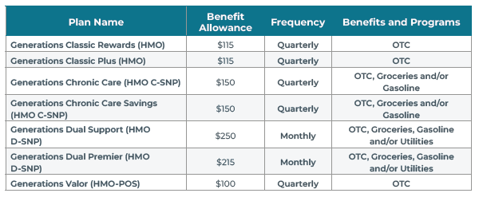
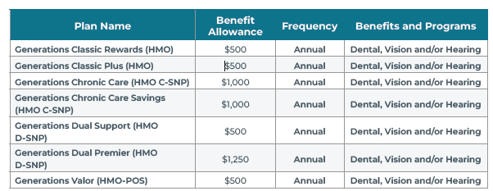
Smart Wallet Benefit
Please note that all plans do not offer all categories.
GlobalHealth has partnered with NationsBenefits to give members the Smart Wallet, a Benefits Mastercard® Prepaid Card. This card will hold monthly/quarterly/annual allowances for:
Dental
Vision
Hearing
Over-the-Counter
Groceries
Utilities
Gasoline

Slide 12
No Referrals to See a Medicare Advantage Specialist
Members do not need a referral from their PCP to visit a SCP in our provider Medicare Advantage network
Members can simply schedule an appointment and go
Available on all plans
Certain services performed by a SCP may require prior authorization; always check the EOC

Slide 13
Pharmacy
Pharmacy Benefit Manager (PBM):
CVS Caremark for GlobalHealth Members
There are several ways you can help your patients save money:
Many drug tiers have cost-sharing breaks for the Member in 100-day supplies versus 30-day supplies
Prescribe a generic whenever appropriate
MA Members may save money by filling prescriptions at a preferred cost-sharing pharmacy rather than a standard cost-sharing pharmacy
Mail Order Pharmacy Service
CVS Caremark offers the convenience of mail order at the same cost-sharing as preferred pharmacies.

Slide 14
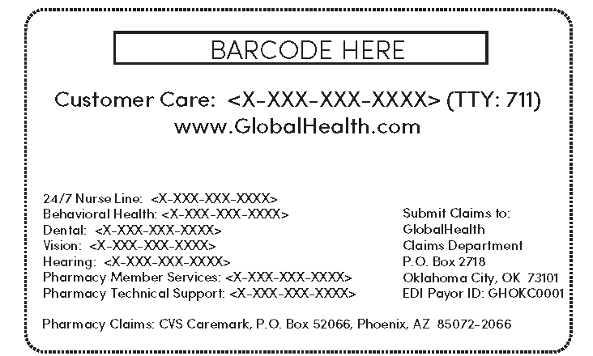
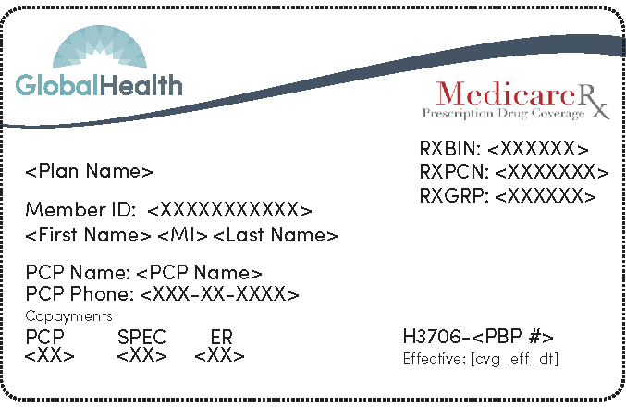
Sample Member ID Card
Front
Back

Slide 15
Provider Portal
Provider Portal is an online tool available to all Contracted Providers which allows you to:
Verify eligibility
Review Member demographics
View benefit information
Create referrals
Check prior authorization/referral review status
Check claim status
The Provider Portal will be available 24/7.
You may access information about Provider
Portal on the Provider tab of our website: www.GlobalHealth.com.
Email provider.relations@globalhealth.com
with questions

Slide 16
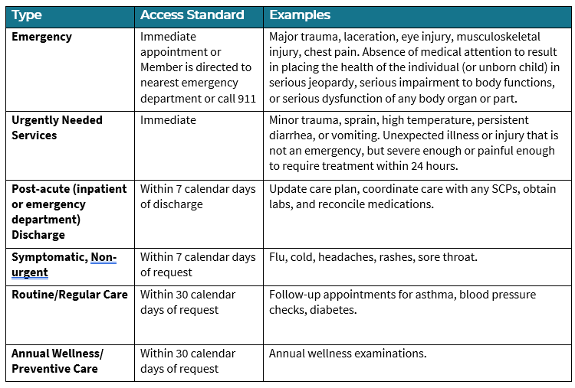
Provider Responsibilities
Complete the Provider Update Form found at www.GlobalHealth.com, Provider Tab within 30 days of when there are any changes to your tax ID number, NPI, address, telephone, fax number, name, location(s), and limitations/restrictions to practice.
Comply with Access and Availability Timeliness Standards
Notify GlobalHealth for Member reassignments when a primary care physician leaves the group.

Slide 17
Authorizations
Prior authorization decisions are made in a timely manner to accommodate the clinical urgency of the patient’s situation.
Urgent Concurrent: Determination made within 24 hours of receipt of request
Urgent Preservice: Determination made within 72 hours of receipt of request
Non-Urgent Preservice: Determination made within 14 days of receipt of request
The PCP is responsible for submitting a Prior Authorization when necessary and for supplying complete clinical information concerning the Referral to the receiving Specialist Physician or facility. The Specialist Physician can request subsequent Prior Authorizations as needed. Prior Authorizations are required whether GlobalHealth is the primary or secondary payer.

Slide 18
Authorizations
Things to Note
The office should verify eligibility and confirm authorization using the Provider Portal prior to the visit or service.
The authorization will state the services that are approved.
The approved services must occur within the approved time frame from the date of the authorization.
If the authorization covers more than one visit or service, the provider must verify eligibility at the time of each visit. Payment will not be made for services rendered to an ineligible member.
Notify GlobalHealth within 24 hours regarding any unexpected services that were medically necessary but were not included in the original prior authorization.

Slide 19
Hospital Admissions
In addition to the authorization, GlobalHealth must be notified by the hospital of all admissions within 24 hours of admission. Although prior authorization is not required for some services, notification is required.
The following reports are required to be provided daily to GlobalHealth’s UM Department:
Census report for all GlobalHealth Members
Discharge Report
Inpatient and outpatient surgeries, observation stays, and Skilled Nursing Facility (SNF) admissions, if applicable.

Slide 20
Hospital Admissions
Concurrent Review
GlobalHealth performs concurrent review from the day of admission through discharge to assure the medical necessity of each day, that services are provided at the appropriate level of care, and that necessary discharge arrangements are being/have been made.
Discharge Planning
Transition of care management/discharge planning starts at the time of hospital admission or when the admission is authorized and continues throughout the discharge process. It includes the coordinate of a patient’s continued care needs both in and out of the inpatient setting.

Slide 21
Behavioral Health Benefits
Members can directly access mental health and/or substance use disorder services by calling the Carelon Behavioral Health Customer Care number listed on the back of their Member ID card. Assistance is available for those that need translation or are hearing impaired.

Slide 22
Claims
GlobalHealth will reimburse for Covered Health Care Services on timely filed claims in accordance with contractual agreements and applicable statutory requirements less any applicable copayments or coinsurance owed by the member.
GlobalHealth’s electronic data interchange (EDI) number is GHOKC0001.
Contracted Providers must use the
provider portal to obtain claim status.

Slide 23
Claims
Balance Billing
A contracted provider accepts the GlobalHealth reimbursement as payment in full and may NOT “balance bill” a GlobalHealth member.
In other words, the contracted provider may not look to a GlobalHealth member for payment for covered health care services beyond the member’s applicable deductible, copayment and/or coinsurance amounts.
Balance billing is a violation of the agreement and may result in termination of the contracted provider from the GlobalHealth network.

Slide 24
Claims
Qualified Medicare Beneficiary
Medicare providers and suppliers may not bill GlobalHealth members in the Qualified Medicare Beneficiary (QMB) Program for Medicare deductibles, coinsurance, or copays. State Medicaid programs may pay for those costs.
Under some circumstances, federal law lets states limit how much they pay providers for Medicare cost-sharing. Even when that’s the case, people in the QMB program have no legal obligation to pay Medicare providers for Medicare Part A or Part B cost-sharing.
https://www.cms.gov/Medicare-Medicaid-Coordination/Medicare-and-Medicaid-Coordination/Medicare-Medicaid-Coordination-Office/QMB>

Slide 25
Claims
Provider Payment Disputes/Claim Reviews
A provider may request a claim review if any part of a claim submitted for payment is either fully or partially denied. The appropriate claim review form can be found at www.GlobalHealth.com, Provider tab.
Claim reviews may be resolved by attaching any pertinent documents to support the claim (e.g., sending proof of timely filing, sending a copy of the authorizations for claims denied for no authorization).

Slide 26
Remittance Advice (RA)
The RA GlobalHealth issues summarizes the claim and explains how the benefits were applied. Use the RA to determine how a claim was paid including non-allowed amounts and adjustments. The RA will note any non-covered services and cost sharing amounts that are the responsibility of the member. The RA lists and explains all codes used in processing each claim. Claim details can also be obtained through the Provider Portal.

Slide 27
EFT and ERA – Zelis
GlobalHealth has partnered with Zelis for electronic claims remittance and payments. This alliance provides us with the latest in secure electronic payment technology by accelerating and adding efficiency to our claims payment process.
Enrolling is fast and easy! Visit https://globalhealth.zelisenroll.com/ and follow the registration process.
Zelis Payments Client Services can be reached at (877) 828-8770 or (855) 496-1571.

Slide 28
Other
Provider Manual and Other Forms and Resources
The provider manual includes valuable information about working with GlobalHealth and our policies. Please become familiar with it as it is an extension of your provider contract. It can be found in the Provider section on our website at www.GlobalHealth.com. All other forms and resources can be found on our website as well.
Provider Satisfaction
To continually improve upon health plan services, GlobalHealth may conduct Provider Experience Surveys. The survey identifies the providers’ level of satisfaction.
Online Directory
www.GlobalHealth.com
Member Complaints and Grievances
If a member files a complaint against a provider, GlobalHealth will contact the provider for additional information, which may include a request for an explanation or medical records, to ensure all the facts are obtained before responding to the grievance.

Slide 29
GH_16700324

